Slide 1


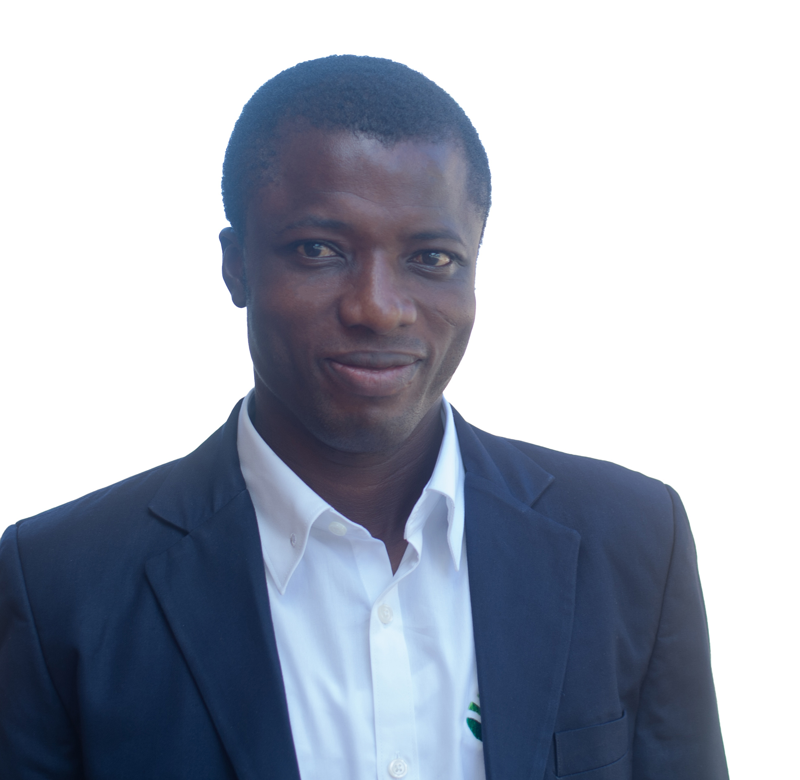
Getting to Know Me
Work
Personal
My role
Human Resources Manager - Operations
Significant others / family members / furry friends in my life
Family is very paramount to me
Tenure in ofi/Olam
14 Years
How I enjoy spending my free time
I enjoy my quite moments
Previous companies I have worked at
None
My favorite / comfort food
Plain rice with chicken and soup
Why I joined ofi/Olam and what keeps me here?
From school the objective was to get a job. Upon joining, I have loved to contribute my quota to building a live work place for all colleagues.
My favorite song
Coat of many colours
Linus Langkuu
‘Linus’
A few fun facts about me
I am lovely but very comfortable being myself. I can be very reserved to those who are new and do not know me. I do not make friends so quickly
This is me outside work, doing stuff I enjoy in my life …

